Slide 1
Students Data Analysis
Python data manipulation and visualization
Dataset = Student_Data(Uploaded on github)
Dataset Columns = 'Gender', 'EthnicGroup', 'ParentEduc', 'LunchType', 'TestPrep', 'ParentMaritalStatus', 'PracticeSport', 'IsFirstChild', 'NrSiblings',
'TransportMeans', 'WklyStudyHours', 'MathScore', 'ReadingScore',
'WritingScore'

Slide 2
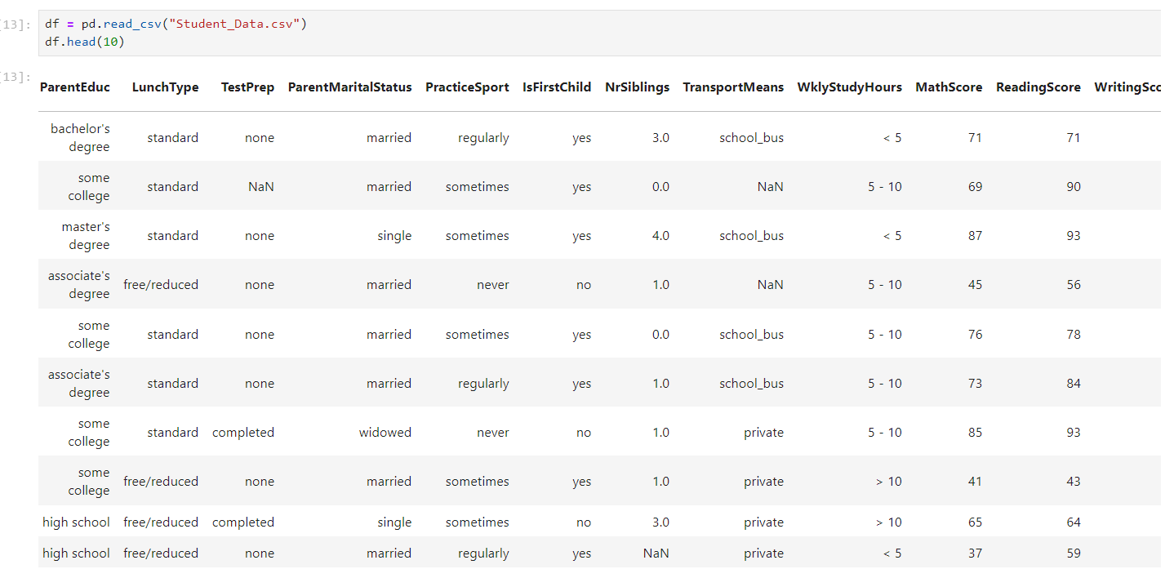
Data Distribution

Slide 3
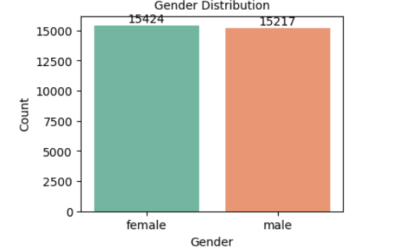
Gender Distribution

Slide 4
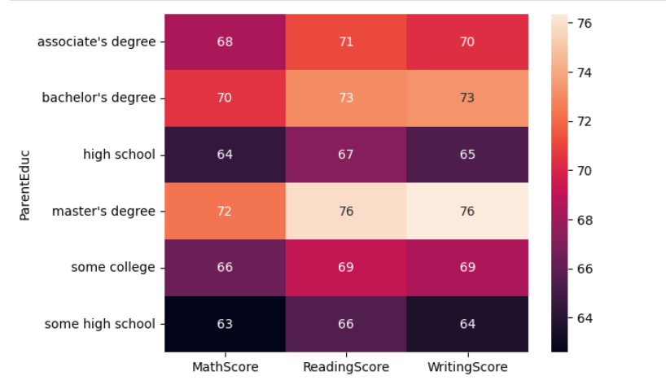
effect of parents education on their child's Scores

Slide 5
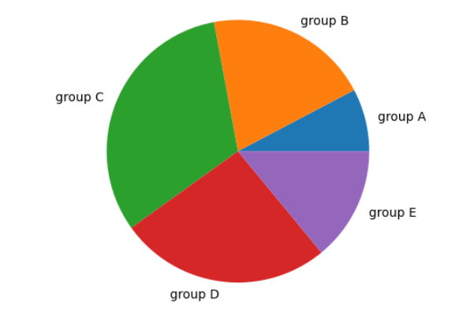
ethnic group ditribution

Slide 6
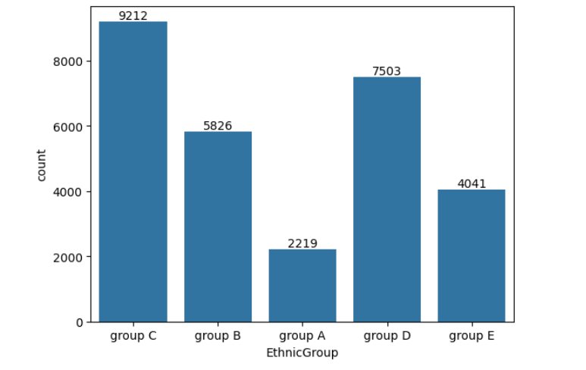
ethnic group ditribution with countplot

